Slide 1
Deep Learning for Vessel Segmentation in Cerebral CTA
A Controlled Ablation of Topology-Aware Loss Functions
Samih Tharwat Amer
Whiting School of Engineering | Johns Hopkins University
Midterm Project | April 2026

Slide 2
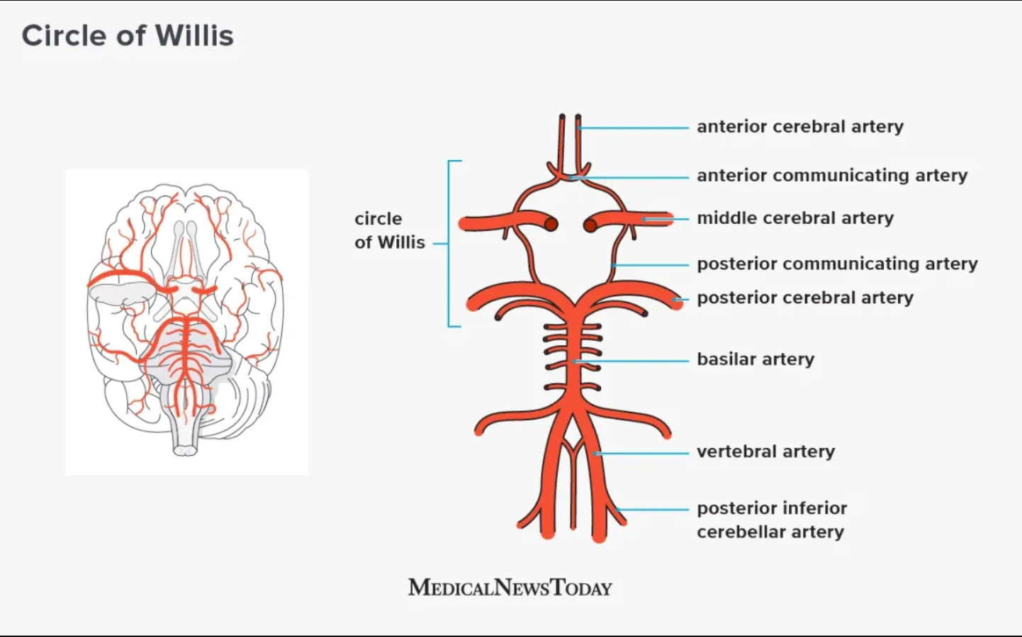
01
Clinical Motivation
Cerebrovascular diseases are a leading cause of death and disability worldwide
Vessel segmentation from CTA is essential for diagnosis, surgical navigation, and treatment planning
Circle of Willis (CoW) — the arterial ring at the brain's base — provides collateral blood flow
Communicating arteries (Acom, Pcom) are thin but clinically critical for aneurysm assessment

Slide 3
02
The Problem: Topological Failures
Dice + Cross-Entropy loss treats all voxels equally — no connectivity incentive
A segmentation can have high Dice (0.87) but broken topology — severed vessels, fragments
Aggregate metrics hide failures on thin communicating arteries
"The model missed a significant number of vessels in clinical use,
despite the validation DSC looking reasonable on paper."
Global DSC 0.87 — but R-Pcom DSC 0.42, L-ACA DSC 0.46

Slide 4
03
Hypothesis & Approach
HYPOTHESIS
Topology-aware loss functions will disproportionately improve segmentation of thin communicating arteries (Acom, Pcom)
Config 1
Config 2
Config 3
Dice + CE
Dice + CE + clDice
Dice + CE + Skeleton Recall
Baseline — overlap only
Centerline matching (CVPR 2021)
Centerline recall (ECCV 2024)
Controlled ablation: same architecture, same data, same hardware — only the loss changes

Slide 5
04
Datasets
TopCoW 2024
TopBrain 2025
MICCAI Challenge Dataset
Extended Annotations — Same Scans
125 CTA volumes
13 Circle of Willis vessel classes
Classes: BA, ICA, MCA, PCA, ACA, Acom, Pcom, 3rd-A2
100 train / 25 validation (80/20 split)
Used for from-scratch training
25 CTA volumes (same 25 CT scans as TopCoW subset)
40 vessel classes — 3x more coverage
New: + distal branches, posterior fossa, small arteries, venous sinuses
Binarized ground truth covers far more vasculature
Used for fine-tuning & transfer evaluation

Slide 6
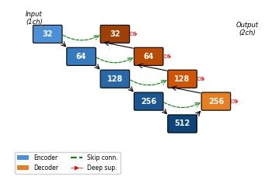
05
Architecture: 3D U-Net
Encoder
5 stages: 32 → 64 → 128 → 256 → 512 channels
Blocks
2× Conv3D + InstanceNorm + LeakyReLU + residual
Down
Strided 2×2×2 convolutions (no max-pool)
Up
Transposed convolutions + skip connections
Deep supervision
1×1 heads at each decoder level
Parameters
24.9M
Design
nnU-Net philosophy (Isensee et al.)

Slide 7
06
Loss Functions
Dice + Cross-Entropy
+ Soft clDice
+ Skeleton Recall
Measures voxel overlap. No connectivity incentive. Standard nnU-Net default.
Computes Dice on skeletons of prediction and ground truth. Differentiable soft-skeletonization (10 iterations of morphological ops).
Precomputes GT skeleton on CPU. Weighted CE on centerline voxels. "Did you find the core of every vessel?"
L = L_CE + L_Dice
L = (1-α)·L_base + α·(1 - clDice)
L = (1-α)·L_base + α·(1 - recall)
All combined with base Dice+CE. Topology weight α = 0.5. Deep supervision wrapper at all decoder scales.

Slide 8
07
Training Setup
Hardware
8× NVIDIA A100-SXM4-40GB (AWS p4d.24xlarge)
Training
DDP across all 8 GPUs — identical for all 3 models
Epochs
300 (from-scratch) | 150 (TopBrain fine-tuning)
Optimizer
AdamW (LR=1e-3, weight decay=1e-5)
Schedule
Cosine annealing + 10-epoch linear warmup
Patches
128³ voxel crops, 4 per volume, 33% foreground-centered
Batch size
4 per GPU | Mixed precision (AMP)
Validation
Every 25 epochs | Early stopping patience = 5
Fine-tuning
LR=1e-4, fresh optimizer, 5-epoch warmup
All training configuration is identical across the three runs — controlled comparison

Slide 9
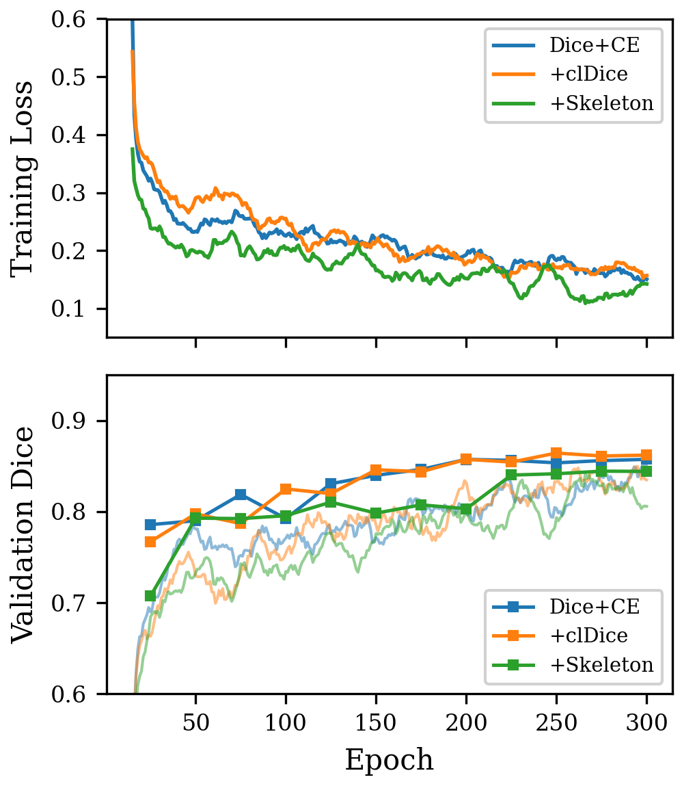
08
Training Dynamics
All three models converge to similar training loss (~0.10-0.13) and validation Dice (~0.84-0.86). clDice and Dice+CE curves are nearly identical. Skeleton Recall runs at slightly higher loss — expected from the additional centerline penalty. Stable convergence, no NaN batches across all configurations.

Slide 10
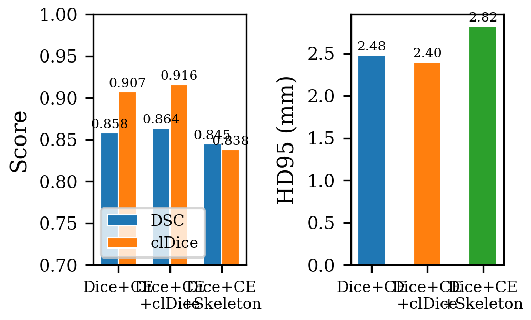
09
Global Results — From Scratch
clDice wins aggregate:
DSC 0.864 | clDice 0.916
Lowest Betti-0 error: 3.72
Baseline close behind:
DSC 0.858 | clDice 0.907
Skeleton Recall:
Lower aggregate (DSC 0.845)
High Betti-0 error: 26.84
But watch what happens next...

Slide 11
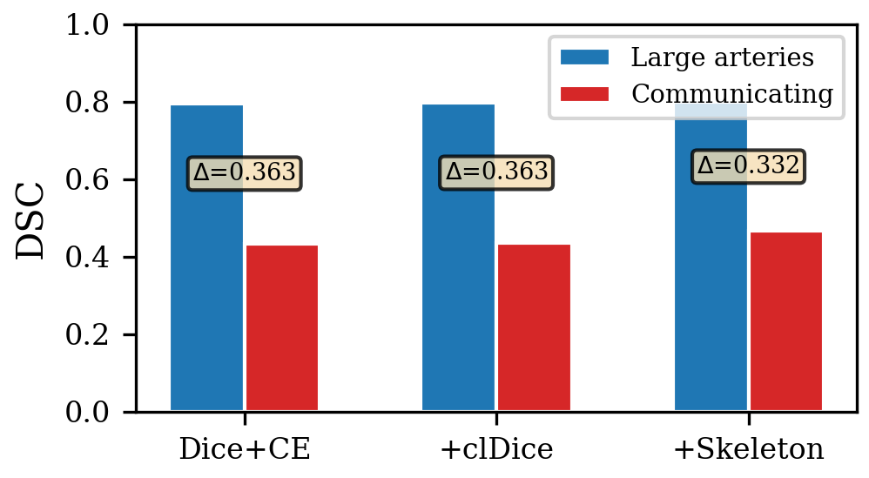
10
Stratified Results — The Vessel Gap
Skeleton Recall improves Pcom:
R-Pcom: 0.511 vs 0.459 baseline
L-Pcom: 0.479 vs 0.410 baseline
(+5 to 7 points on thinnest vessels)
Smallest gap: 0.332
(vs 0.363 for both others)
Hypothesis partially supported:
Modest but targeted improvement
on communicating arteries

Slide 12
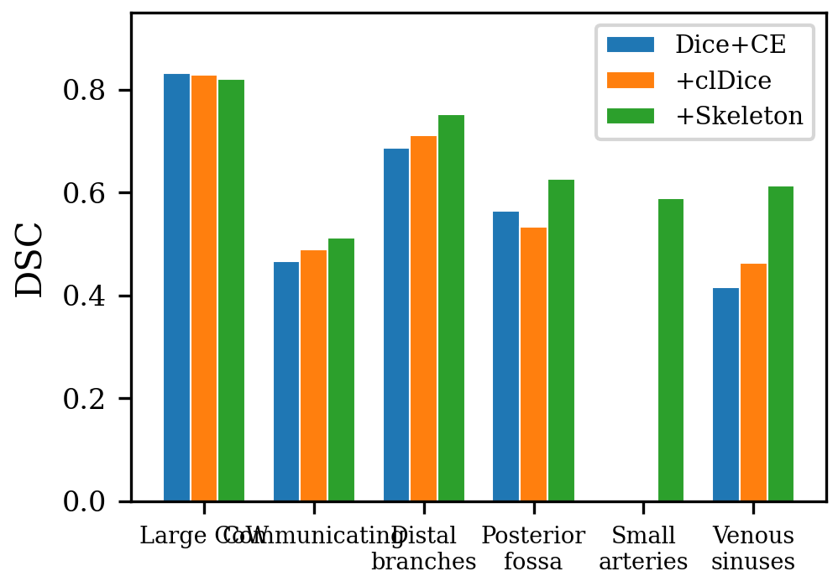
11
TopBrain Fine-Tuning — The Big Result
SMALL ARTERIES (OA, AChA)
Skeleton: 0.589
Dice+CE: 0.000 clDice: 0.000
0.626 vs 0.565Posterior fossa:
0.613 vs 0.416Venous sinuses:
0.752 vs 0.687Distal branches:
all ~0.82 (comparable)Large CoW:
Skeleton Recall finds vessels
the others cannot.

Slide 13
12
Qualitative Comparison — 3D Renderings
[SurgicalAR Screenshot]
[SurgicalAR Screenshot]
Dice+CE + TopBrain
Skeleton Recall + TopBrain
Same patient | Same viewing angle | Same fine-tuning protocol | Different loss during pretraining

Slide 14
13
Discussion — What We Learned
clDice
Skeleton Recall
Best aggregate model
Best thin-vessel transfer
DSC 0.864 | B0 error 3.72
Pcom +5-7 pts | Small arteries 0.589
Improves topological precision
Improves topological recall
Fewer disconnected fragments
Over-segments (B0 error 26.84)
KEY INSIGHT
TopBrain fine-tuning drives comprehensive vessel coverage. The loss function during pretraining shapes how well that coverage transfers to the thinnest structures.

Slide 15
14
Limitations & Future Work
Limitations
Large-small vessel gap persists (>0.33 DSC across all models)
Skeleton Recall over-fragments — Betti-0 error of 26.84 needs post-processing
HU window [0, 600] clips bone (800-2000 HU) to same range as vessels (200-400 HU)
Future Work
Wider HU window [0, 1500] to separate bone from vessels — expected highest-impact fix
Class-balanced sampling to focus on under-represented thin vessels
Connected component filtering to remove small disconnected false positives
Retraining on corrected labels from 50 model-assisted labeled CTA volumes (uploaded to RedBrick AI)

Slide 16
15
Conclusion
Controlled ablation on identical hardware
— 3 loss functions, same 3D U-Net, same 8× A100 config
clDice = best aggregate model
— DSC 0.864, lowest Betti-0 error, best topological precision
Skeleton Recall = best thin-vessel transfer
— +5-7 pts on Pcom, 0.589 on small arteries vs zero
TopBrain fine-tuning drives coverage
— loss function shapes transfer quality to thinnest structures
Hypothesis partially supported
— modest CoW improvement, dramatic effect on truly small vessels

Slide 17
Thank You
Questions?
Samih Tharwat Amer Whiting School of Engineering | Johns Hopkins University

